Slide 1

NLP 논문 구현
2022.05.31.화.
발표자 : 서희재

Slide 2
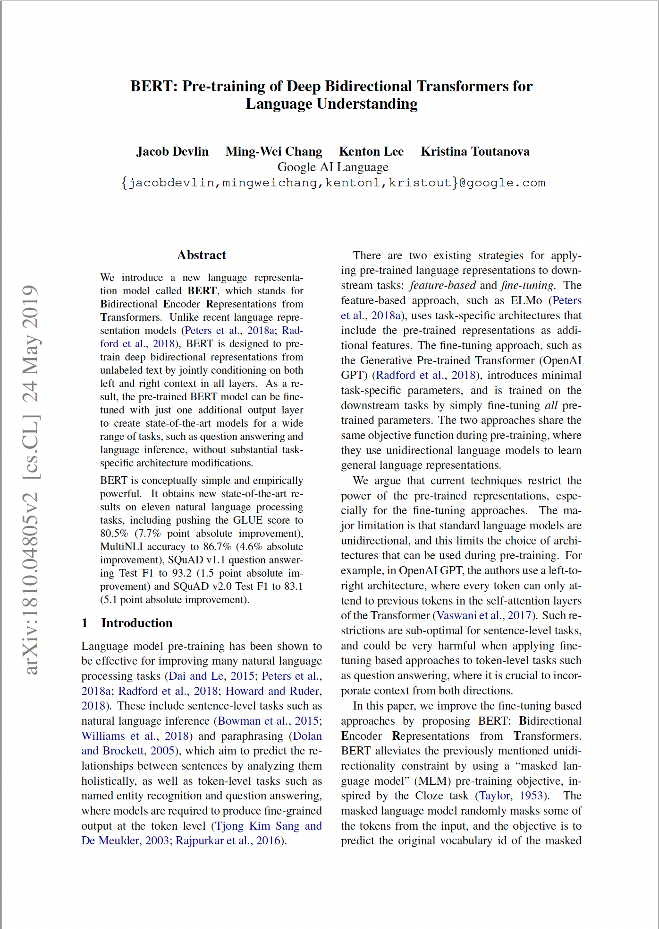
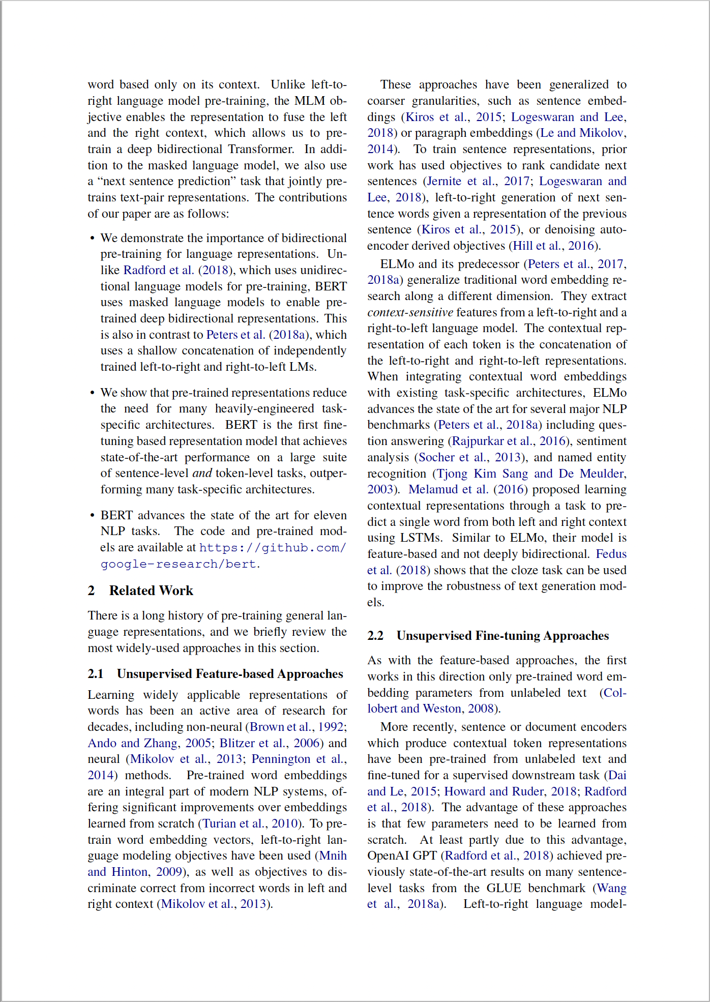
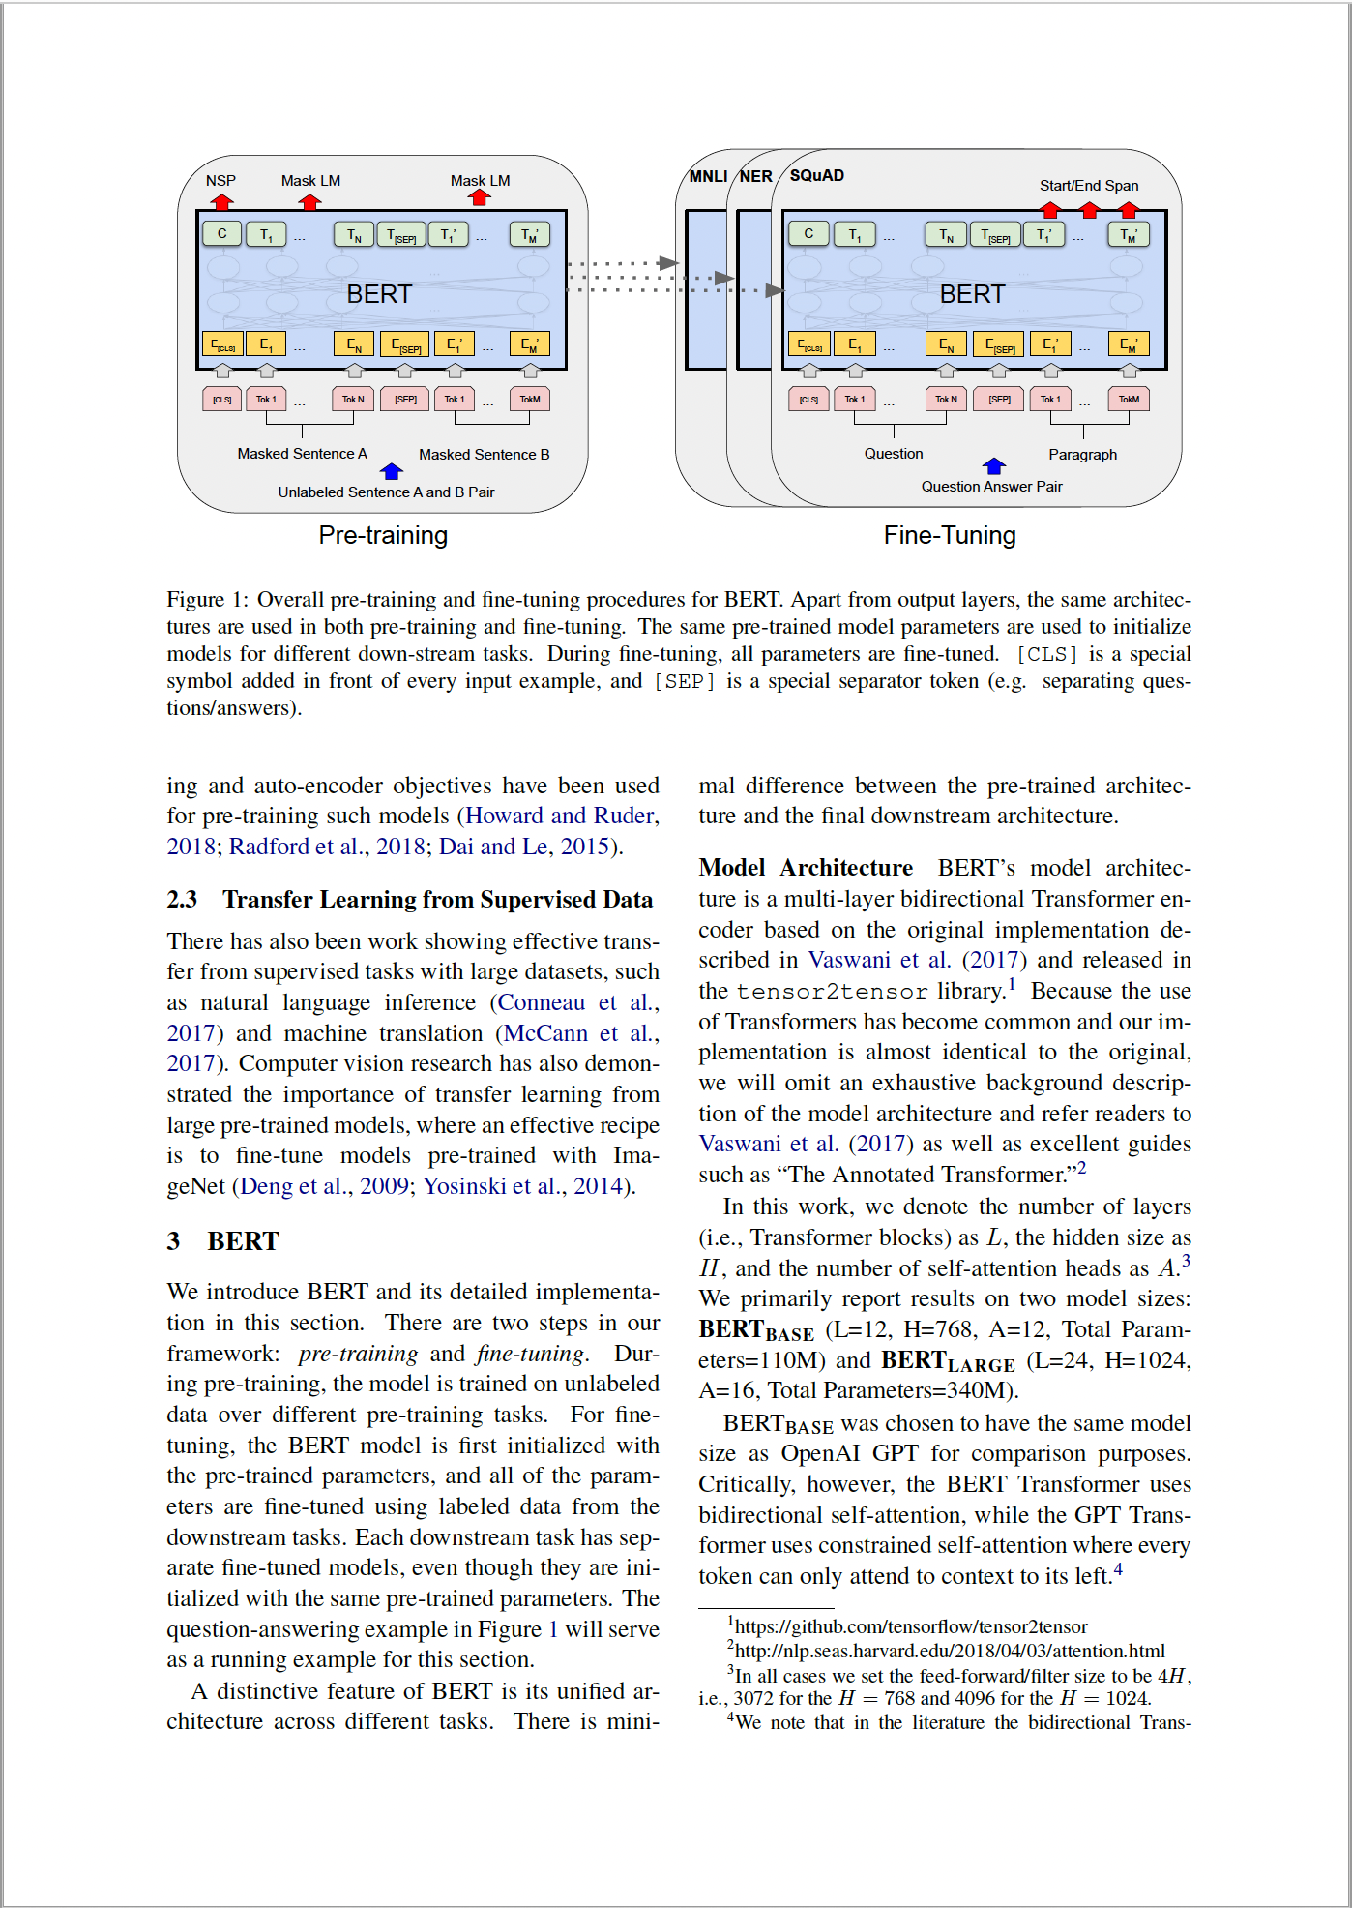
BERT: Pre-training of Deep Bidirectional Transformers for Language Understanding

Slide 3

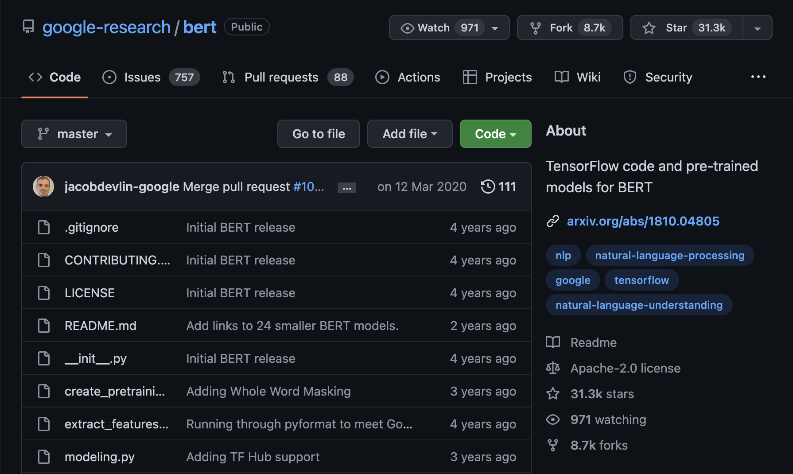
BERT(Bidirectional Encoder Representations from Transformers)

Slide 4
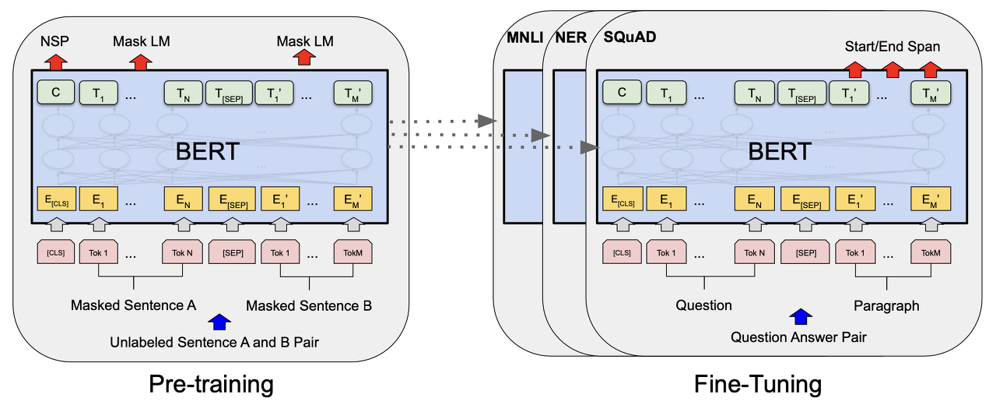
BERT: Pre-trained model
Masked Language Model(MLM)
Next Sentence Prediction(NSP)

Slide 5
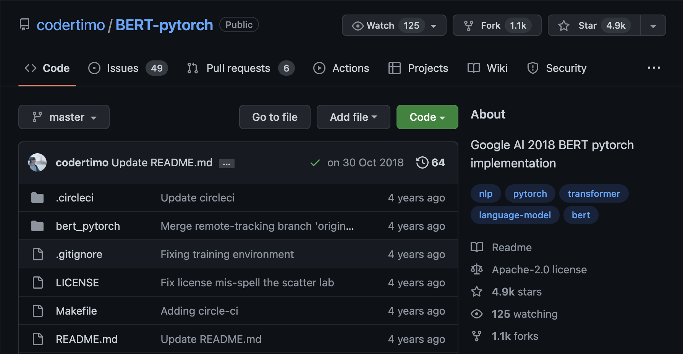
BERT: Practice Code

